Slide 1
Reinvigorating
The SAT
by Evan Jacobs

Slide 2
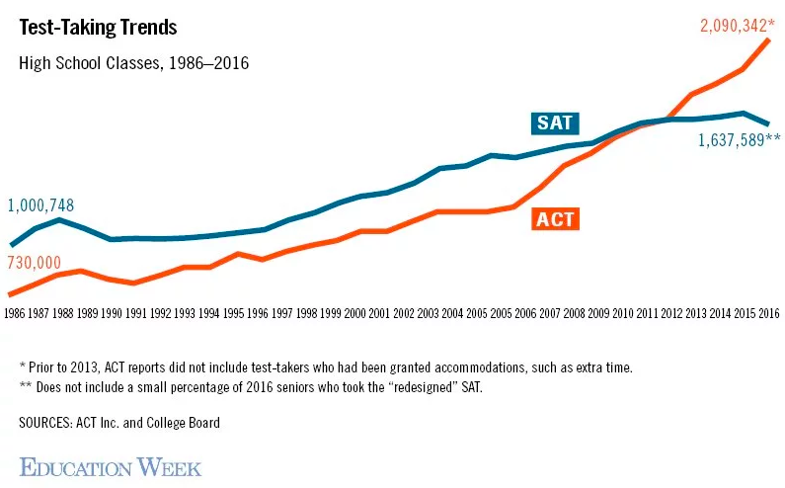
The Problem
https://www.edweek.org/media/2017/05/23/32-sr-assessment-sat-act-graph-c1.jpg

Slide 3
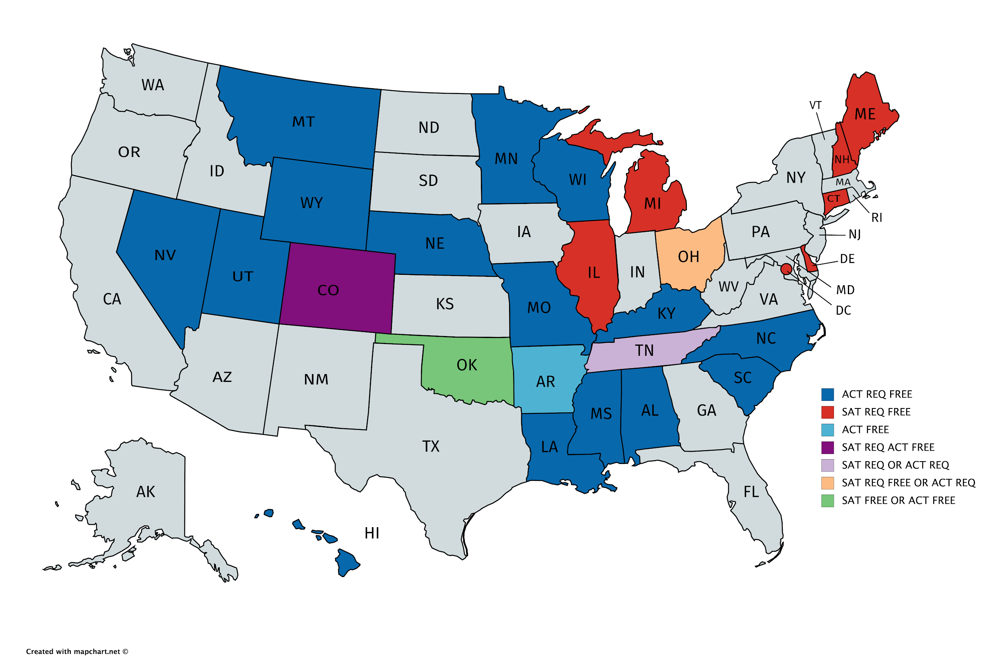
The Data: ACT’s Foothold
ACT required in 15 states: 18.72% of students
SAT required in 7 states and DC: 10.82% of students
https://magoosh.com/hs/act/2017/states-that-require-the-act-or-sat/

Slide 4
The Data: ACT’s Foothold
ACT free in 17 states: 21.37% of students
SAT free in 5 states and DC: 5.51% of students
2 states offer free ACT or free SAT: 4.80% of students
https://magoosh.com/hs/act/2017/states-that-require-the-act-or-sat/

Slide 5
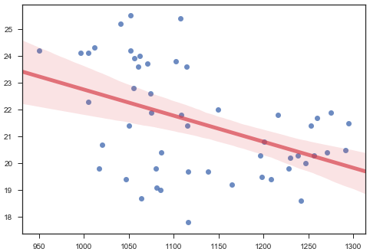
The Data: The SAT Is Everything the ACT Isn’t
Scores between tests are essentially uncorrelated
More data here could help
ACT Composite Score
SAT Total Score

Slide 6
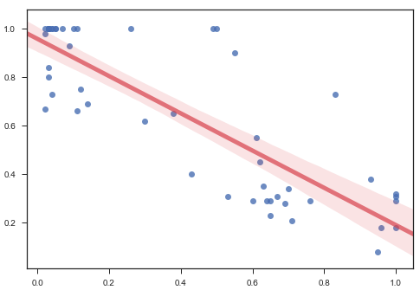
The Data: The SAT Is Everything the ACT Isn’t
Participation rates are slightly negatively correlated
ACT Participation
SAT Participation

Slide 7
Related Issues
The SAT has changed a lot in the past decade and has garnered bad press: https://www.nytimes.com/2014/03/09/magazine/the-story-behind-the-sat-overhaul.html
The ACT is being seen as an attractive alternative to the SAT: https://www.nytimes.com/2016/02/09/us/sat-test-changes.html?hpw&rref=education&action=click&pgtype=Homepage&module=well-region&region=bottom-well&WT.nav=bottom-well
The ACT is regarded as more fair: https://blog.prepscholar.com/the-new-sat-vs-the-act-a-full-breakdown
The SAT has been trying to catch up to the ACT: https://www.princetonreview.com/college/sat-changes

Slide 8
Recommendations
Seek to have more states give free SAT testing and prep.
Having the SAT be free will encourage more students to take it. This will grow the SAT as a whole.

Slide 9
Recommendations
Seek to have more states mandate SAT testing.
This speaks for itself. The SAT should be at least at parity with the ACT in terms of % of US students who must take it.

Slide 10
Recommendations
Market test as an alternative to and different from ACT.
As test scores do not correlate between the SAT and the ACT, on particular way of marketing the SAT would be as a test that a student might do BETTER on if they get an unsatisfactory ACT score, or something to this effect.

Slide 11
Recommendations
Focus on states with no mandates, avoid going head-to-head with ACT.
Trying to get students to take the SAT who live in a state where they must take the ACT will be very difficult. Meanwhile, some of most populous states have no mandates and are ripe for marketing campaigns.

Slide 12
Q & A

Slide 13
THANKS!

